Slide 1
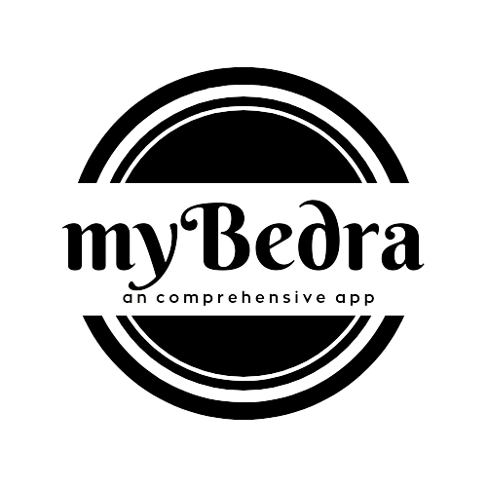
myBedra
1
App that connects bedra

Slide 2
2
- Contents -
Introduction
Existing system
Proposed system
Module description
DFD
ER
Advantages
Disadvantage
Future scope
conclusion

Slide 3
3
- Introduction -
myBedra is a unique mobile application specifically designed to cater to the needs of the residents of Moodbidri town in their day-to-day lives. It aims to provide a comprehensive range of services and information, making it an indispensable tool for the local community. By offering essential town details, transportation services, grocery purchasing, and food delivery, myBedra strives to enhance convenience, efficiency, and connectivity within the community.

Slide 4
4
- Existing system -
Before the introduction of myBedra, residents of Moodbidri town relied on various fragmented sources for different services. They had to refer to multiple platforms, such as bus schedules displayed at stops, phone directories for auto-driver contacts, and separate apps or websites for grocery shopping and food ordering. This disjointed approach often led to inconvenience and inefficiency in accessing essential services and information.

Slide 5
5
- Proposed system -
With the implementation of myBedra, residents of Moodbidri town can now enjoy a centralized platform that integrates a wide range of services and information. The application provides essential town details, including bus timings, enabling users to conveniently plan their daily commutes. It also offers access to contact details of auto-drivers, making it easier to book rides and navigate the town efficiently.
Moreover, myBedra goes beyond transportation services and facilitates convenient grocery purchasing from local stores. Residents can easily access essential items and have them delivered to their doorstep. Additionally, myBedra enables users to order food from various restaurants, streamlining the food delivery experience and providing a seamless solution for residents' culinary needs.
By consolidating these features into a single platform, myBedra creates an ecosystem where locals can access all the necessary information and services directly through their fingertips. The application is built using the Dart programming language and the Flutter framework for a user-friendly frontend. On the backend, a robust Node.js server ensures smooth data processing and handling. The application's data is securely stored and managed in a MySQL database, safeguarding user information and town-related data.

Slide 6
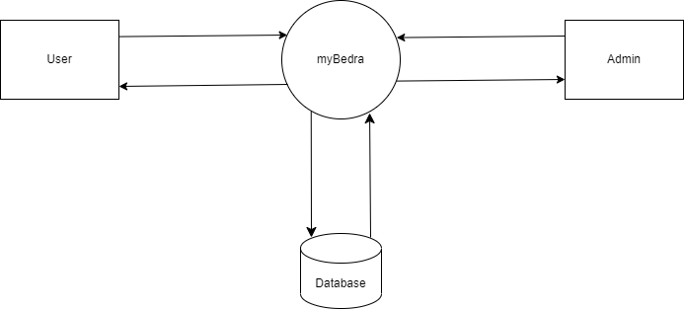
6
- DFD LVL0-

Slide 7
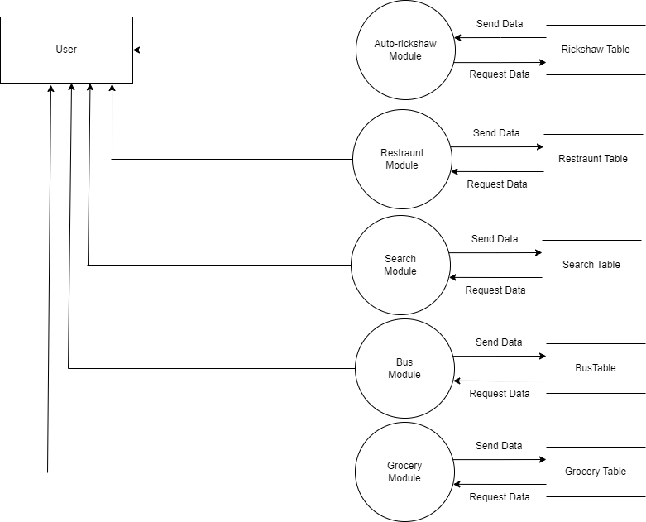
7
- DFD LVL1 USER -

Slide 8
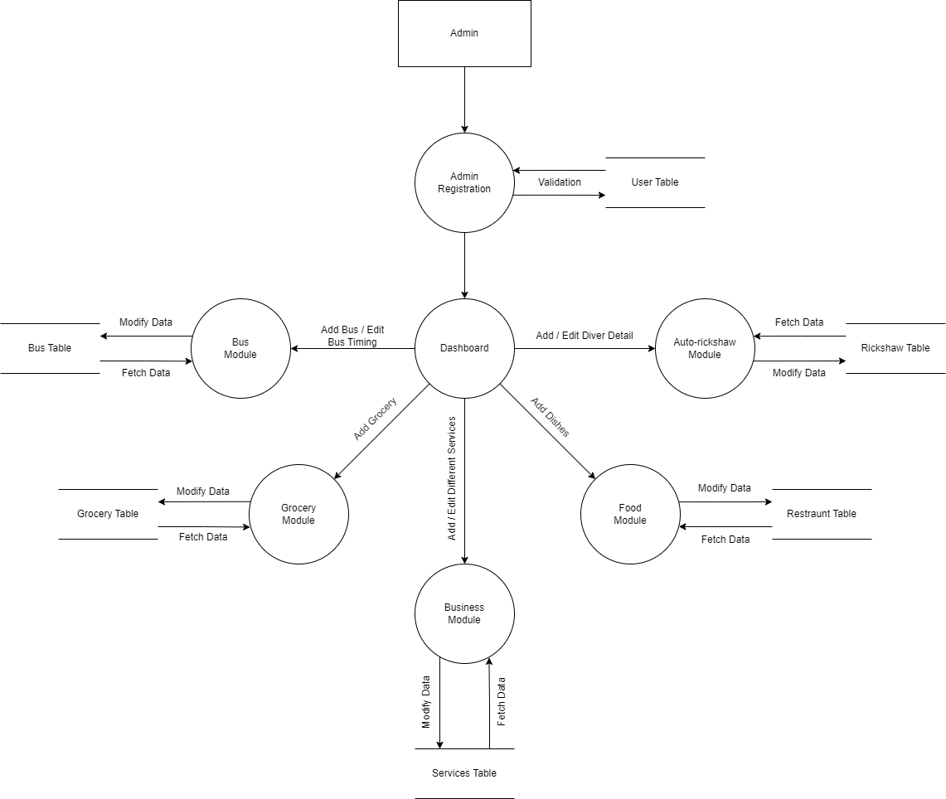
8
- DFD LVL1 ADMIN -

Slide 9
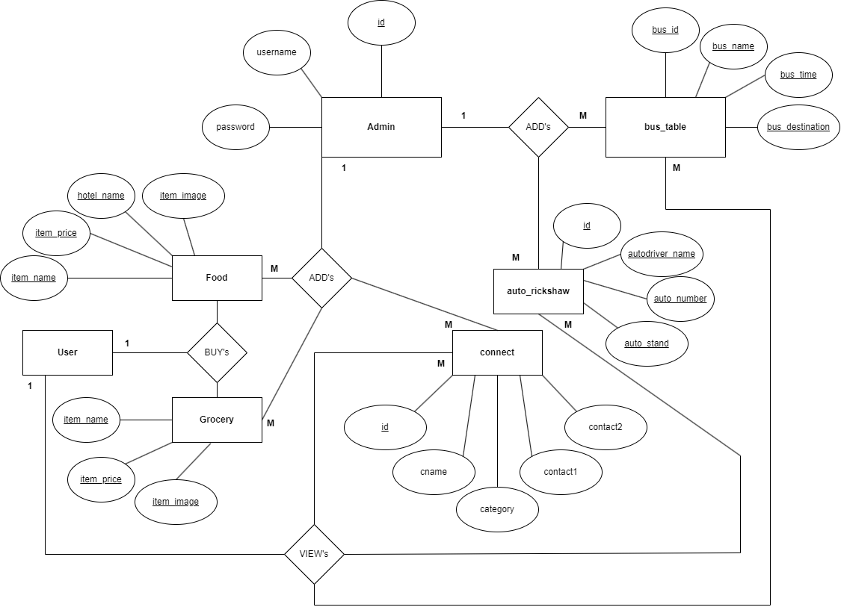
9
- ER -

Slide 10
10
- Module description -
BUS MODULE
This module provides information about the buses available in the town, their timings, and routes. Users can also search for specific bus routes.
AUTORICKSHAW MODULE
This module displays all the autorickshaws available in the town along with their driver names and their phone numbers. Users can call the driver directly by clicking on their profile.
RESTAURANTS MODULE
This module provides information about all the restaurants and hotels in the town, along with their address and contact details. Users can order food using this module.
GROCERY MODULE
This module displays all the grocery available in the vicinity, users can order their desired grocery using this module.
BUSINESS MODULE
This module displays all the business details available in the vicinity, users can make a call to the business using this module.

Slide 11
11
- Advantages -
Convenience: Access multiple services and information from a single platform.
Time-saving: Eliminate the need to navigate multiple apps or websites for different needs.
Comprehensive: Covers essential town details, transportation services, grocery purchasing, and food ordering.
Efficiency: Streamline daily tasks such as checking bus timings and contacting auto-drivers.
Seamless Experience: Order groceries and food with ease, enhancing convenience.
Connectivity: Connects residents with local service providers and promotes community engagement.
User-Friendly Interface: Designed for easy navigation and intuitive user experience.
Real-time Information: Stay updated with the latest bus timings and availability of services.

Slide 12
12
- Disadvantage -
Limited Coverage: myBedra may be limited to serving the residents of Moodbidri town only, excluding users from other areas.
Connectivity Requirements: Accessing and using myBedra may require a stable internet connection, which may not always be available in certain areas.
Reliance on Service Providers: The quality of services such as transportation and food delivery depends on the performance and reliability of local service providers.
Potential Bugs or Glitches: Like any software application, myBedra may encounter occasional bugs, glitches, or performance issues that could disrupt user experience.
Learning Curve: Users unfamiliar with mobile applications may require time to adapt to the features and interface of myBedra.

Slide 13
13
- Future scope -
The myBedra app has immense potential to grow. Payment system can be implemented for bus module, autorickshaw module, groceries module and restaurants module. Order tracking system can be added to groceries and restaurants module. Vehicle tracking system can be added to bus and autorickshaw module.

Slide 14
14
- conclusion -
myBedra is a comprehensive information and communication app designed to cater to the needs of the people living in Moodbidri. It provides users with all the necessary information about various services available in the town, and its future scope is immense. The app has the potential to become a one-stop solution for all the information and communication needs of the people living in Moodbidri.

Slide 15
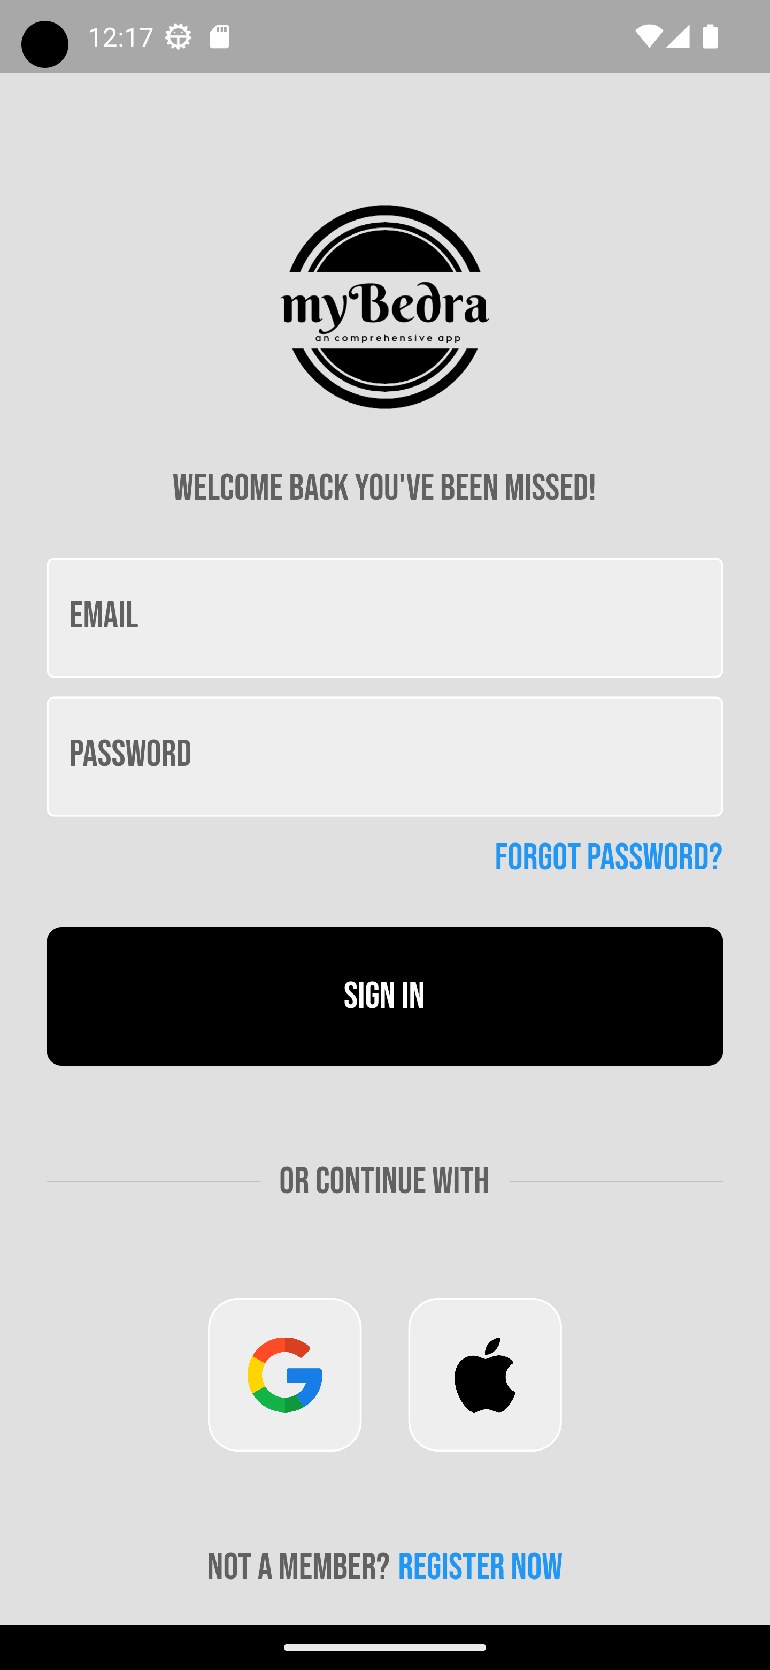
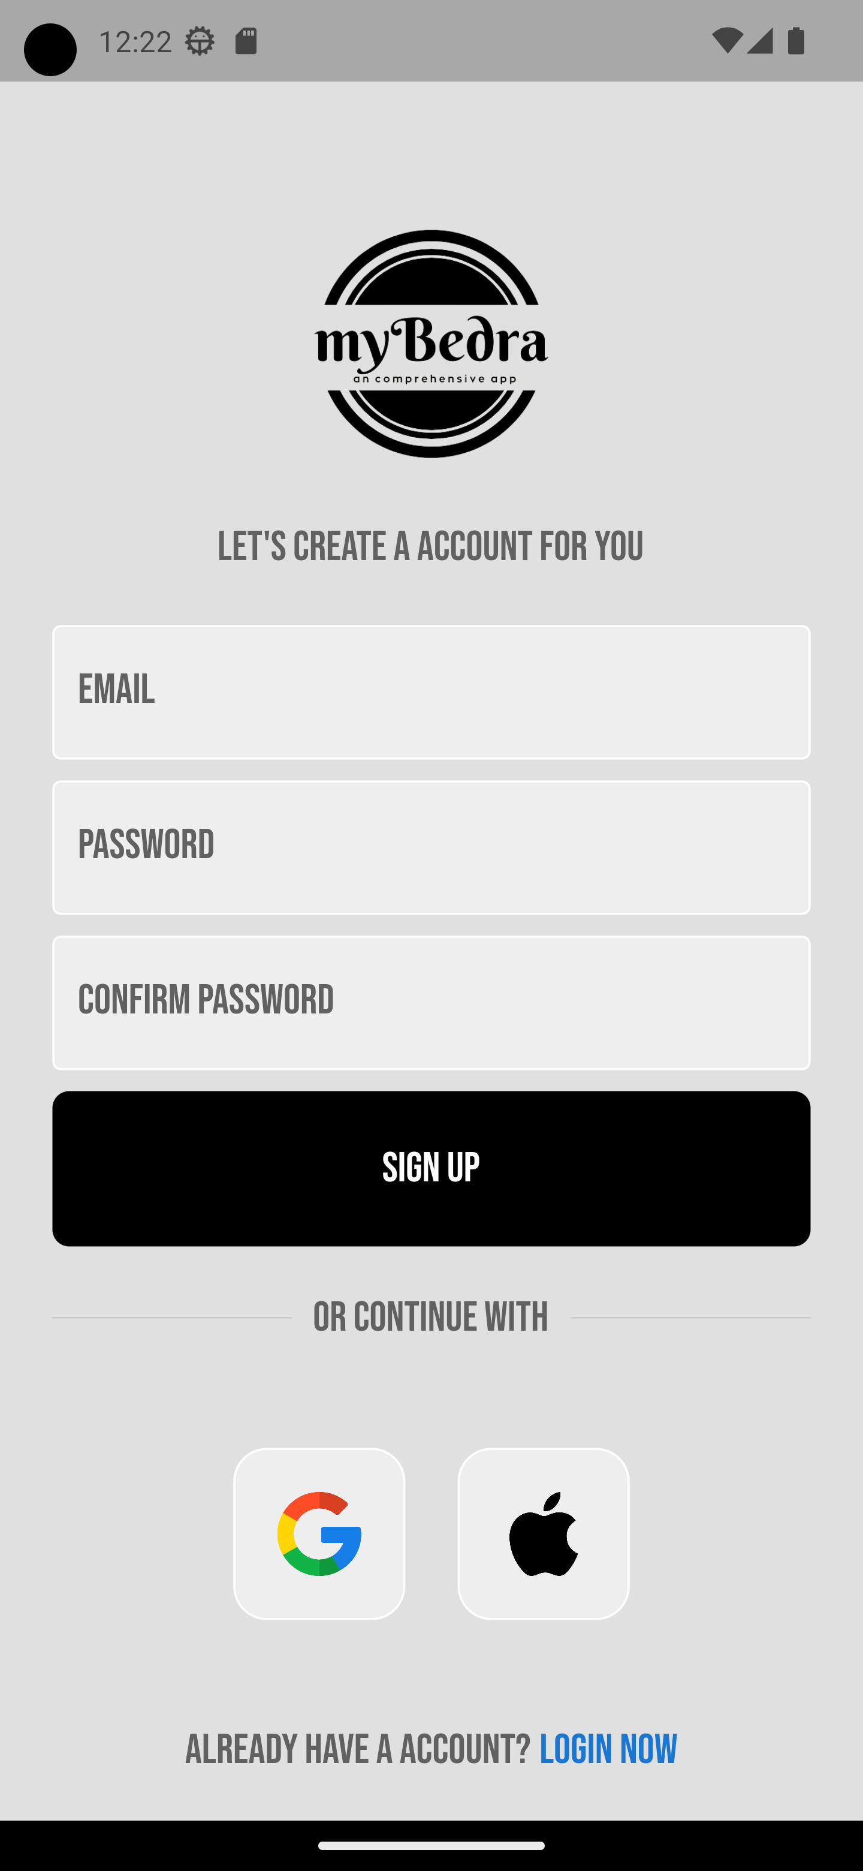
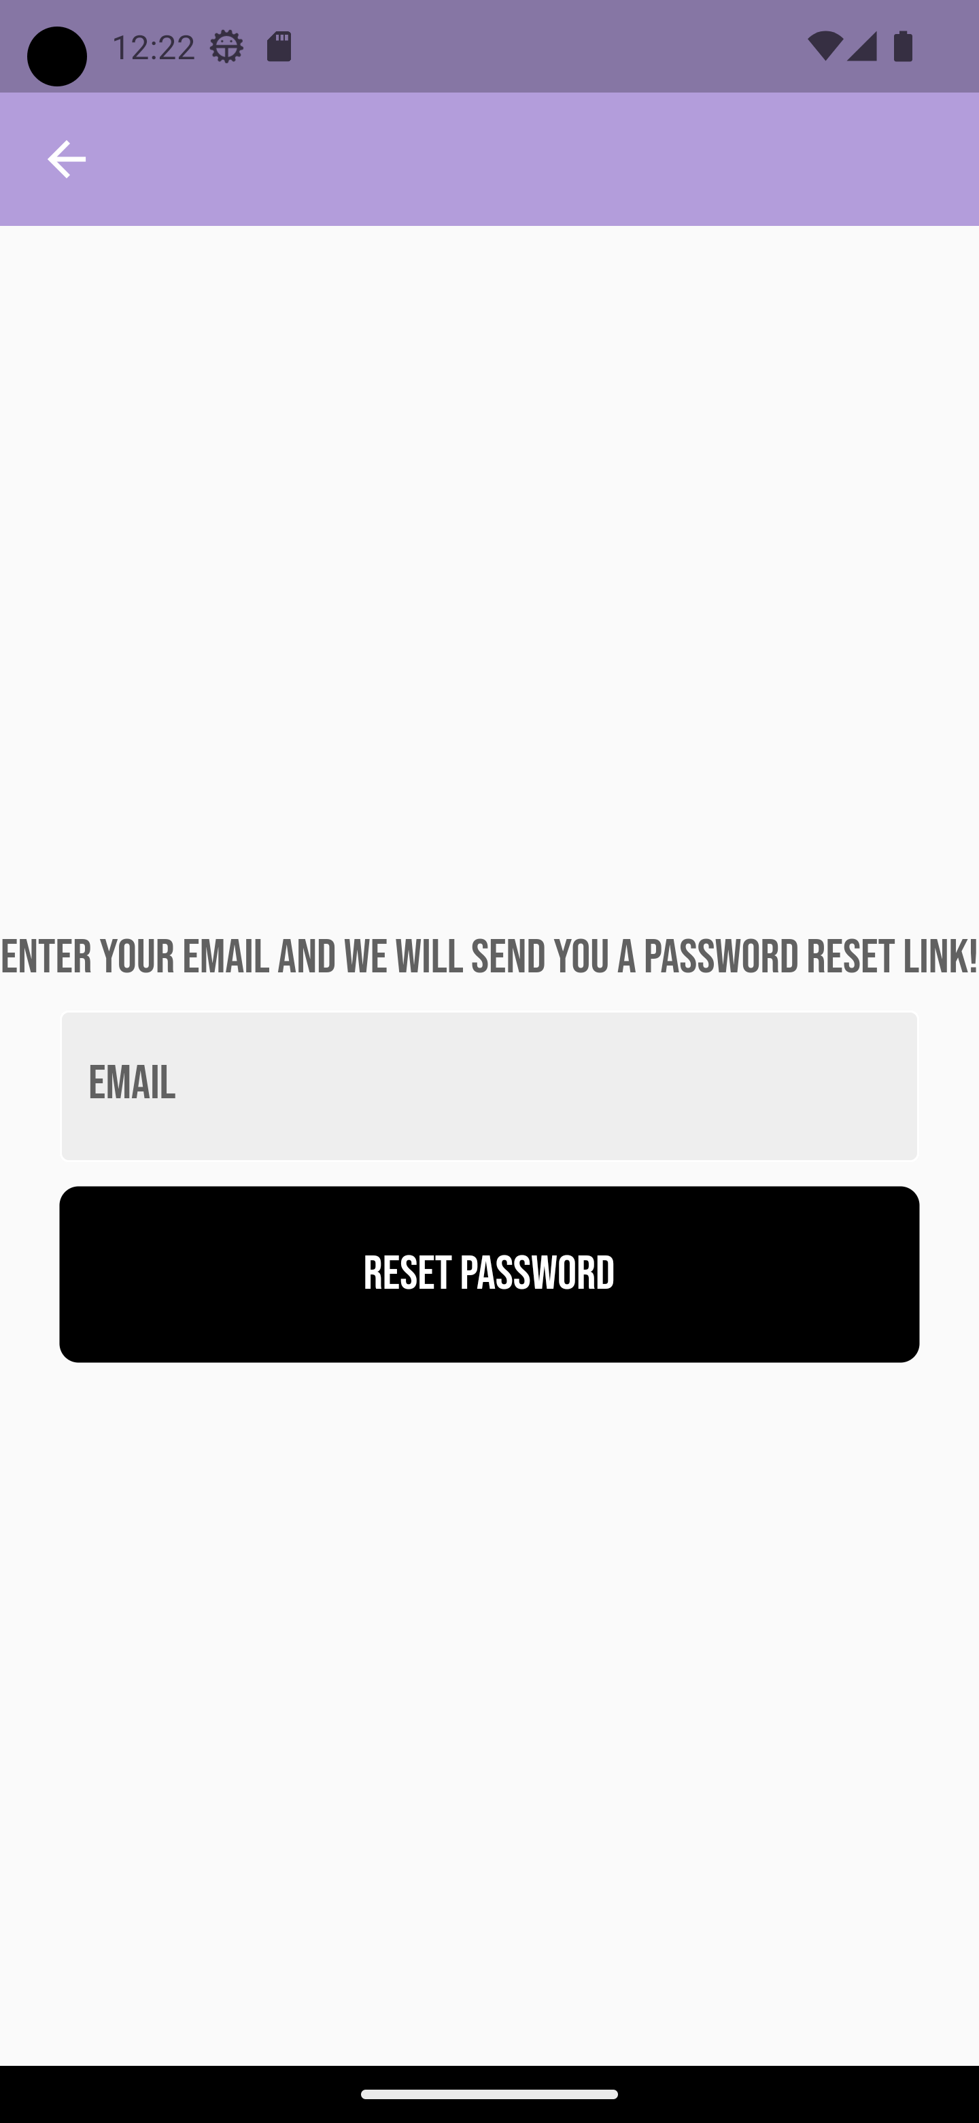
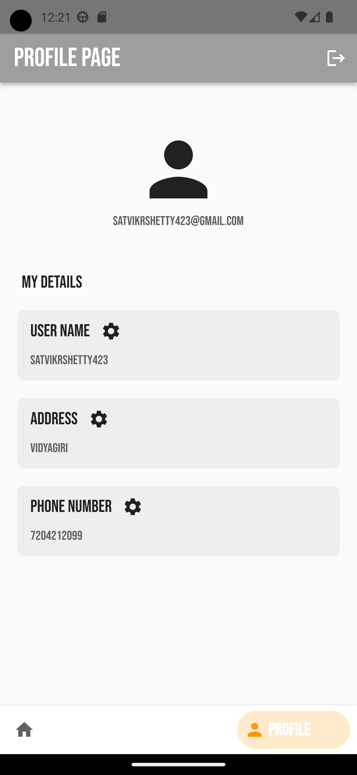
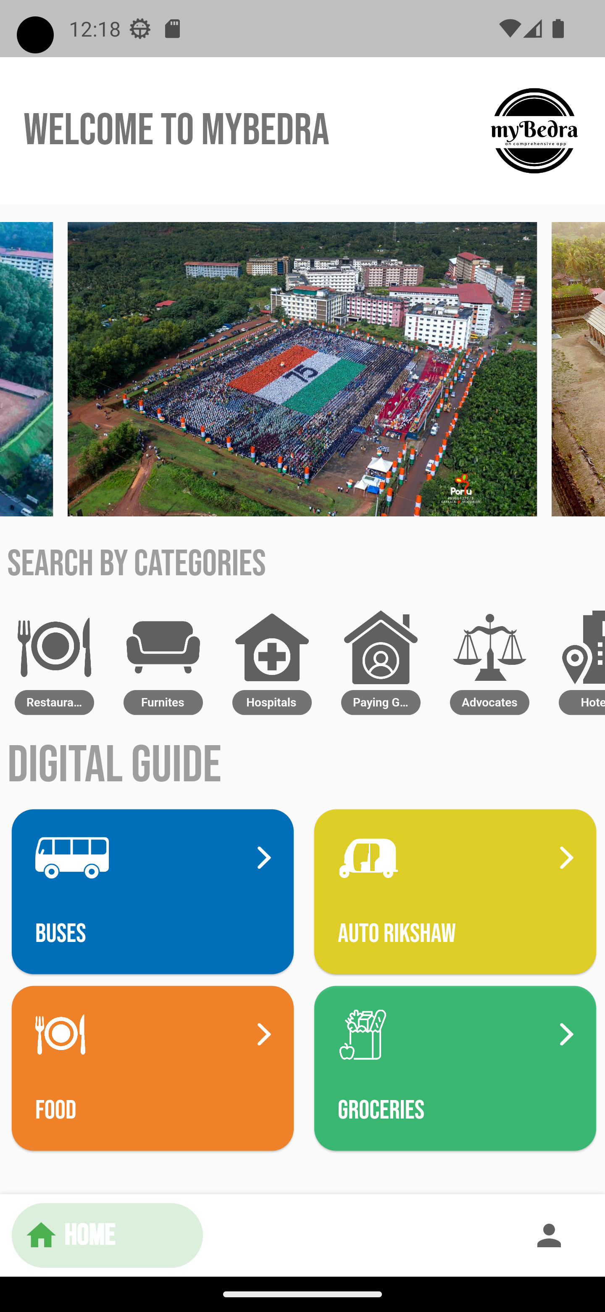
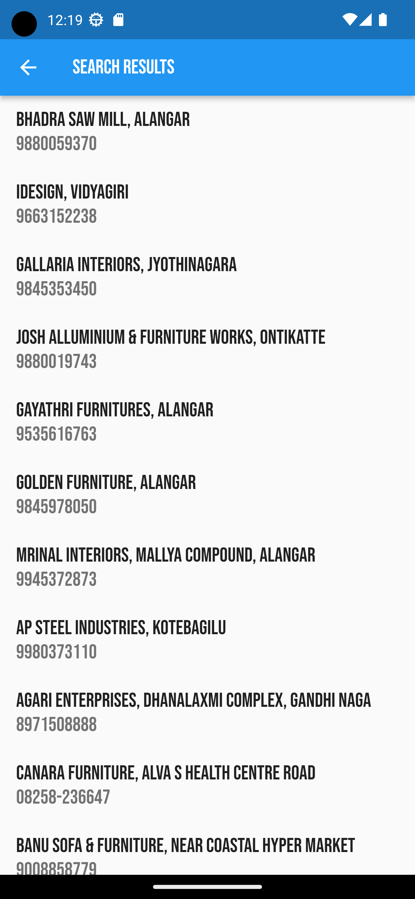
14
- Screen shots -

Slide 16
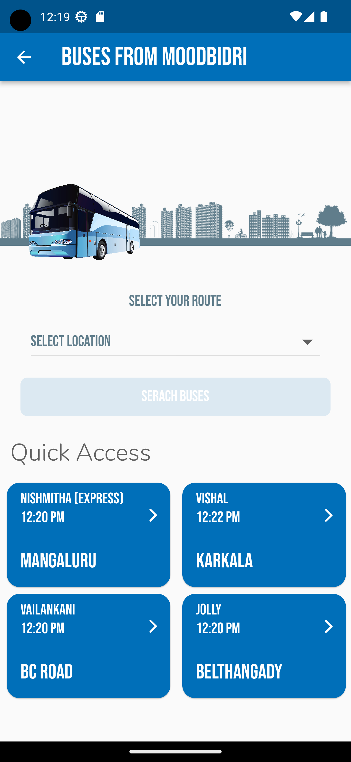
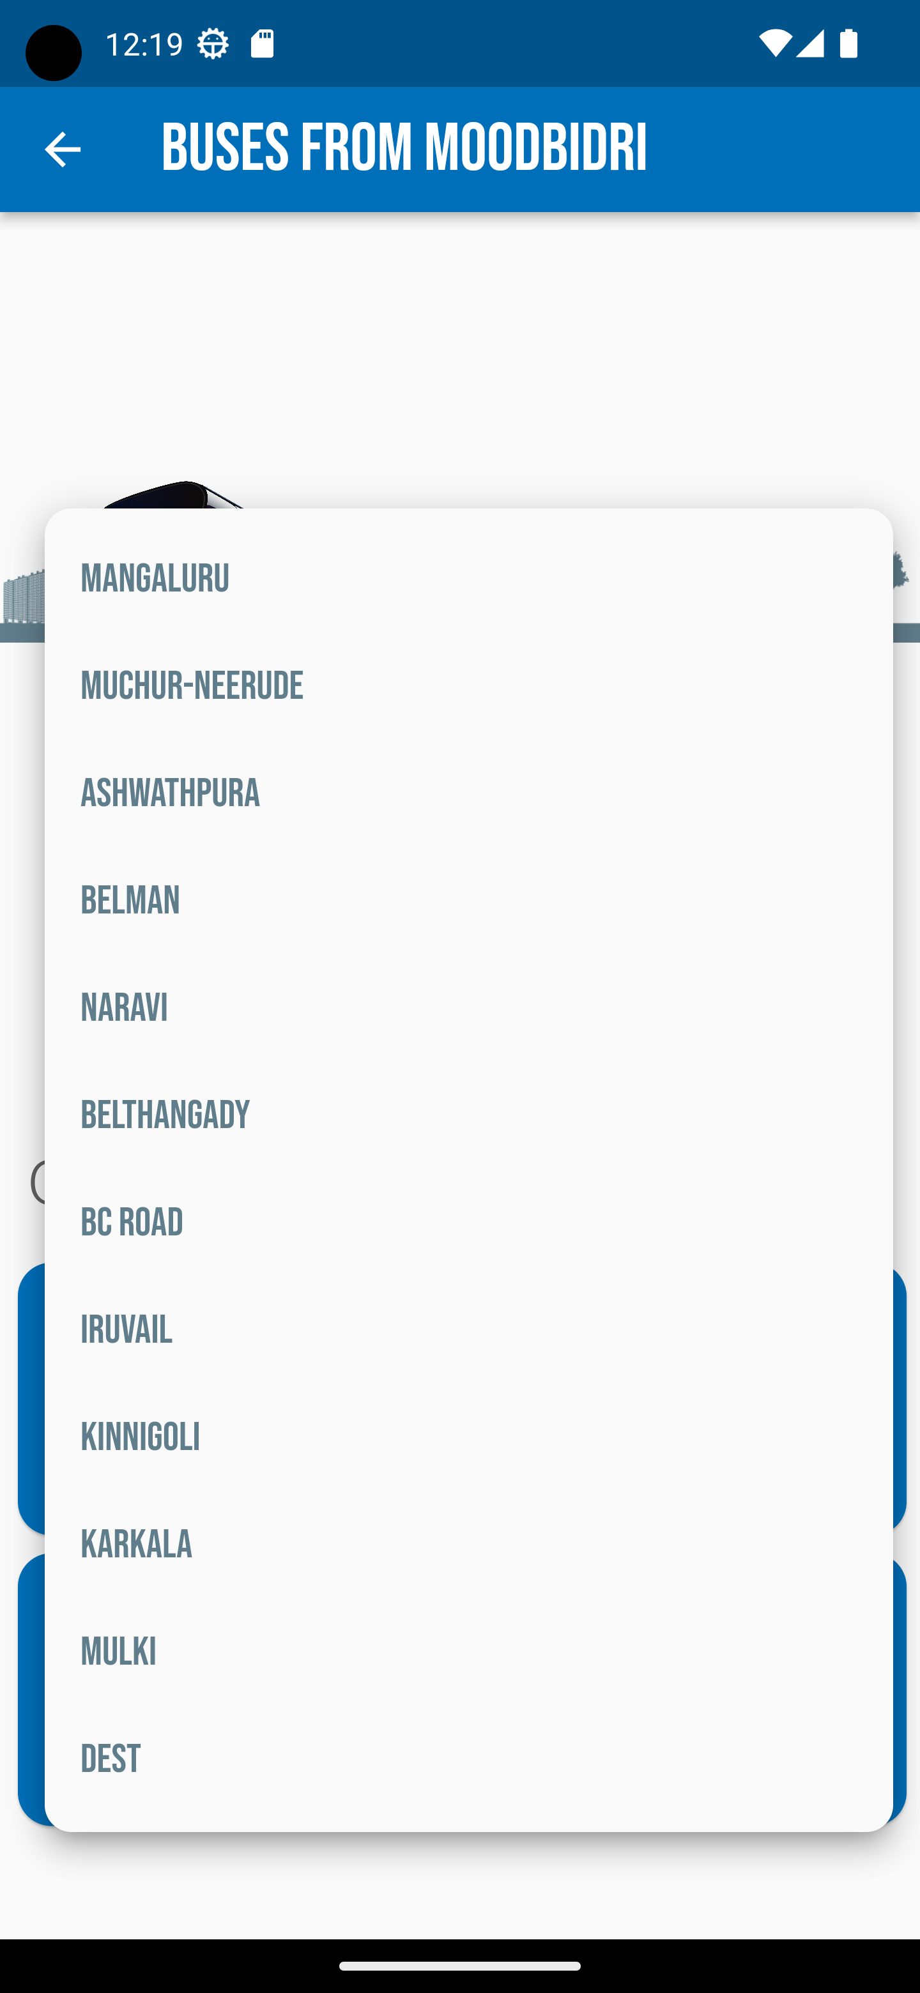
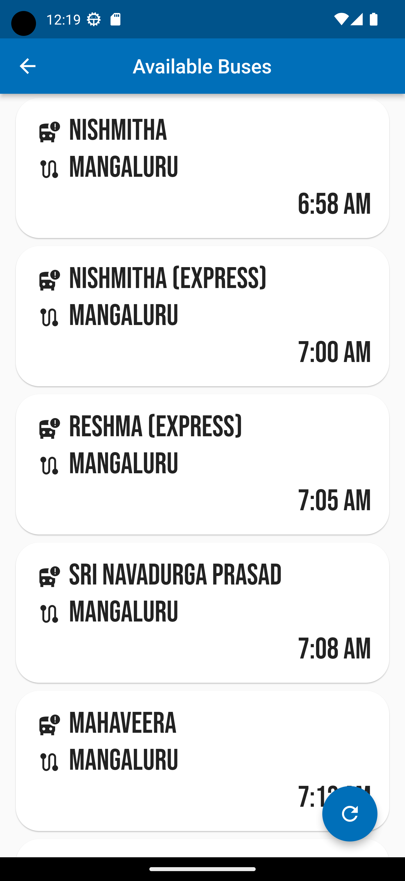
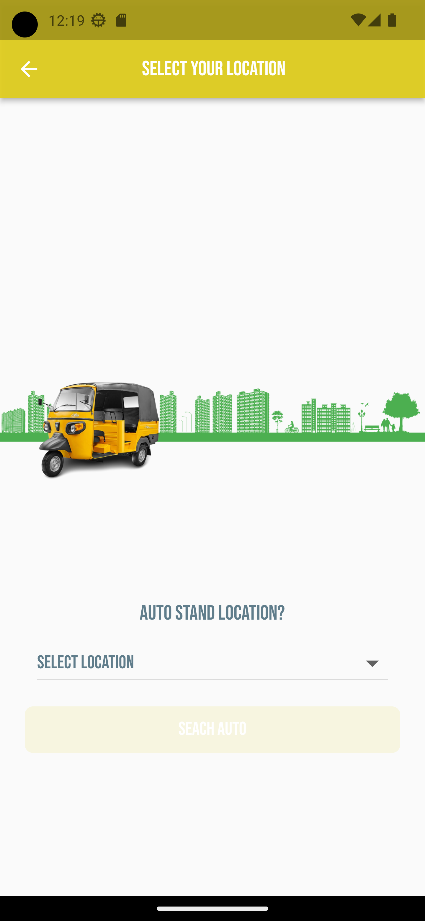
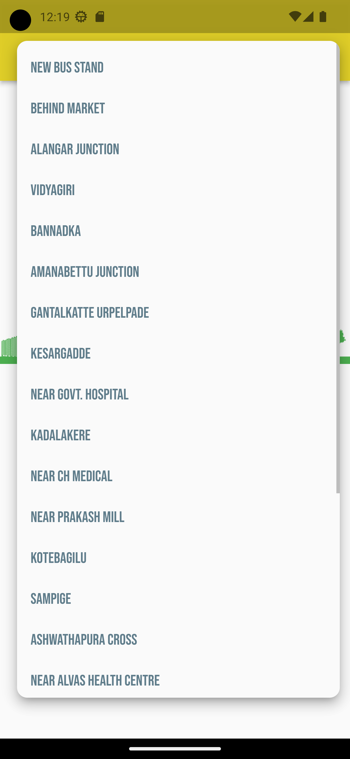
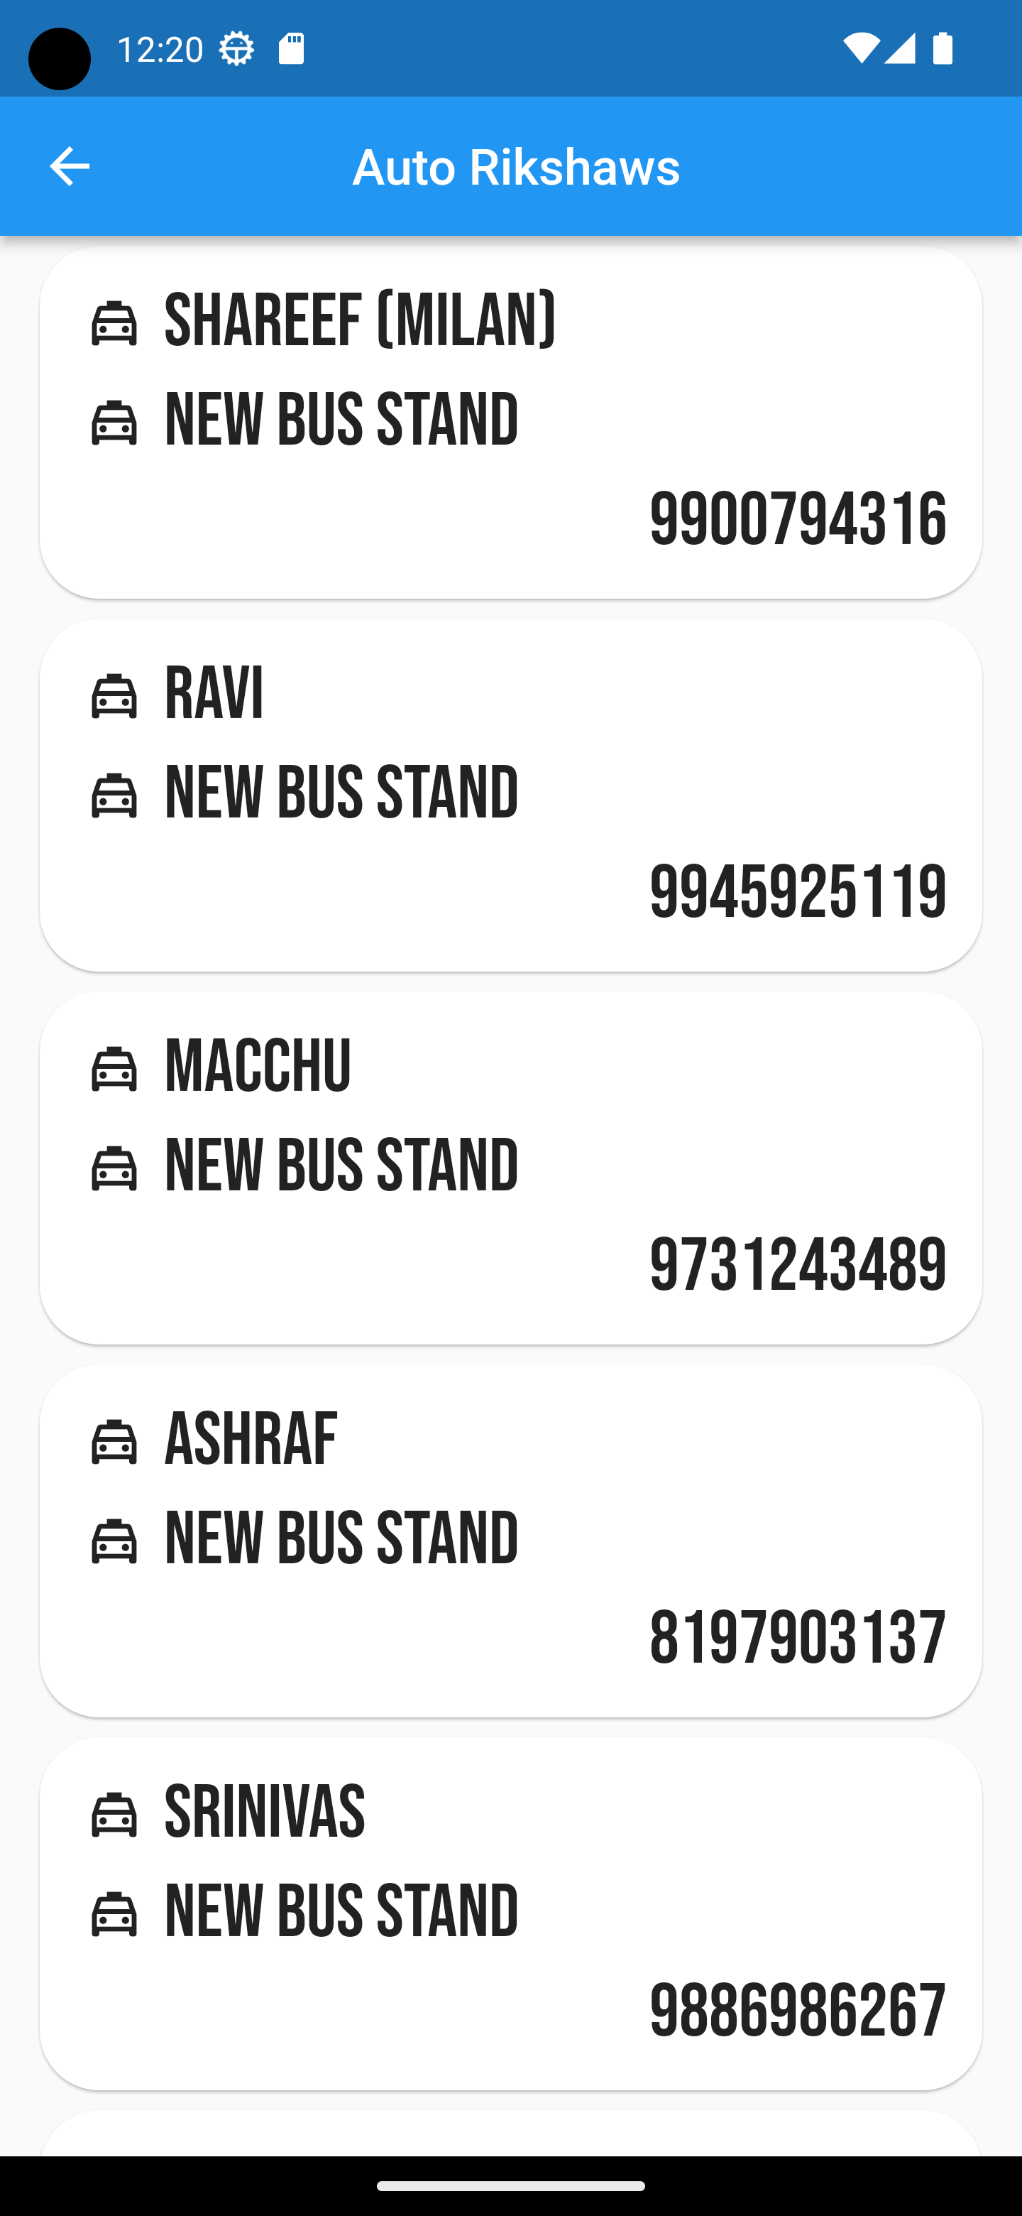
14
- Screen shots -

Slide 17
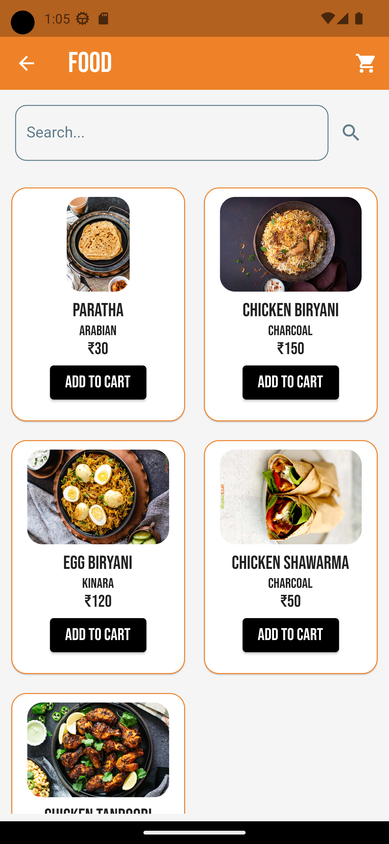
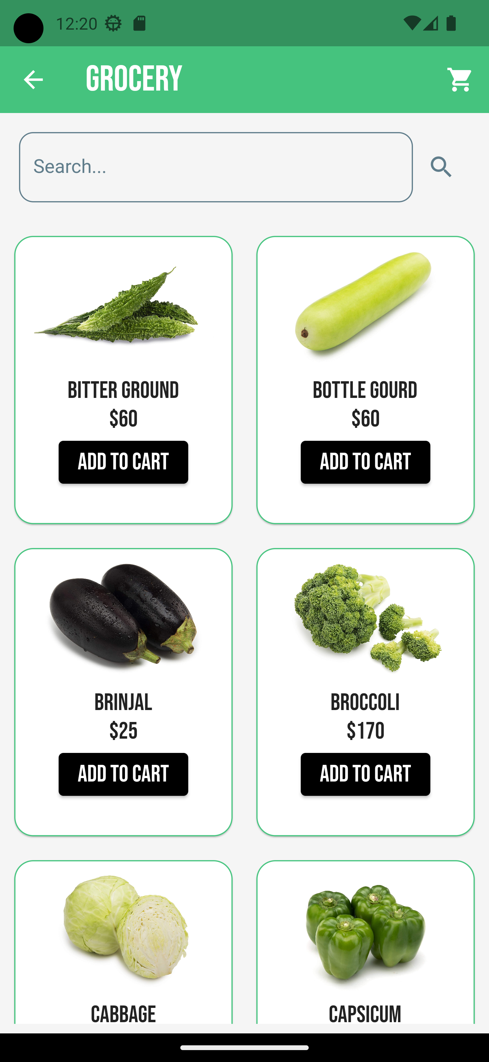
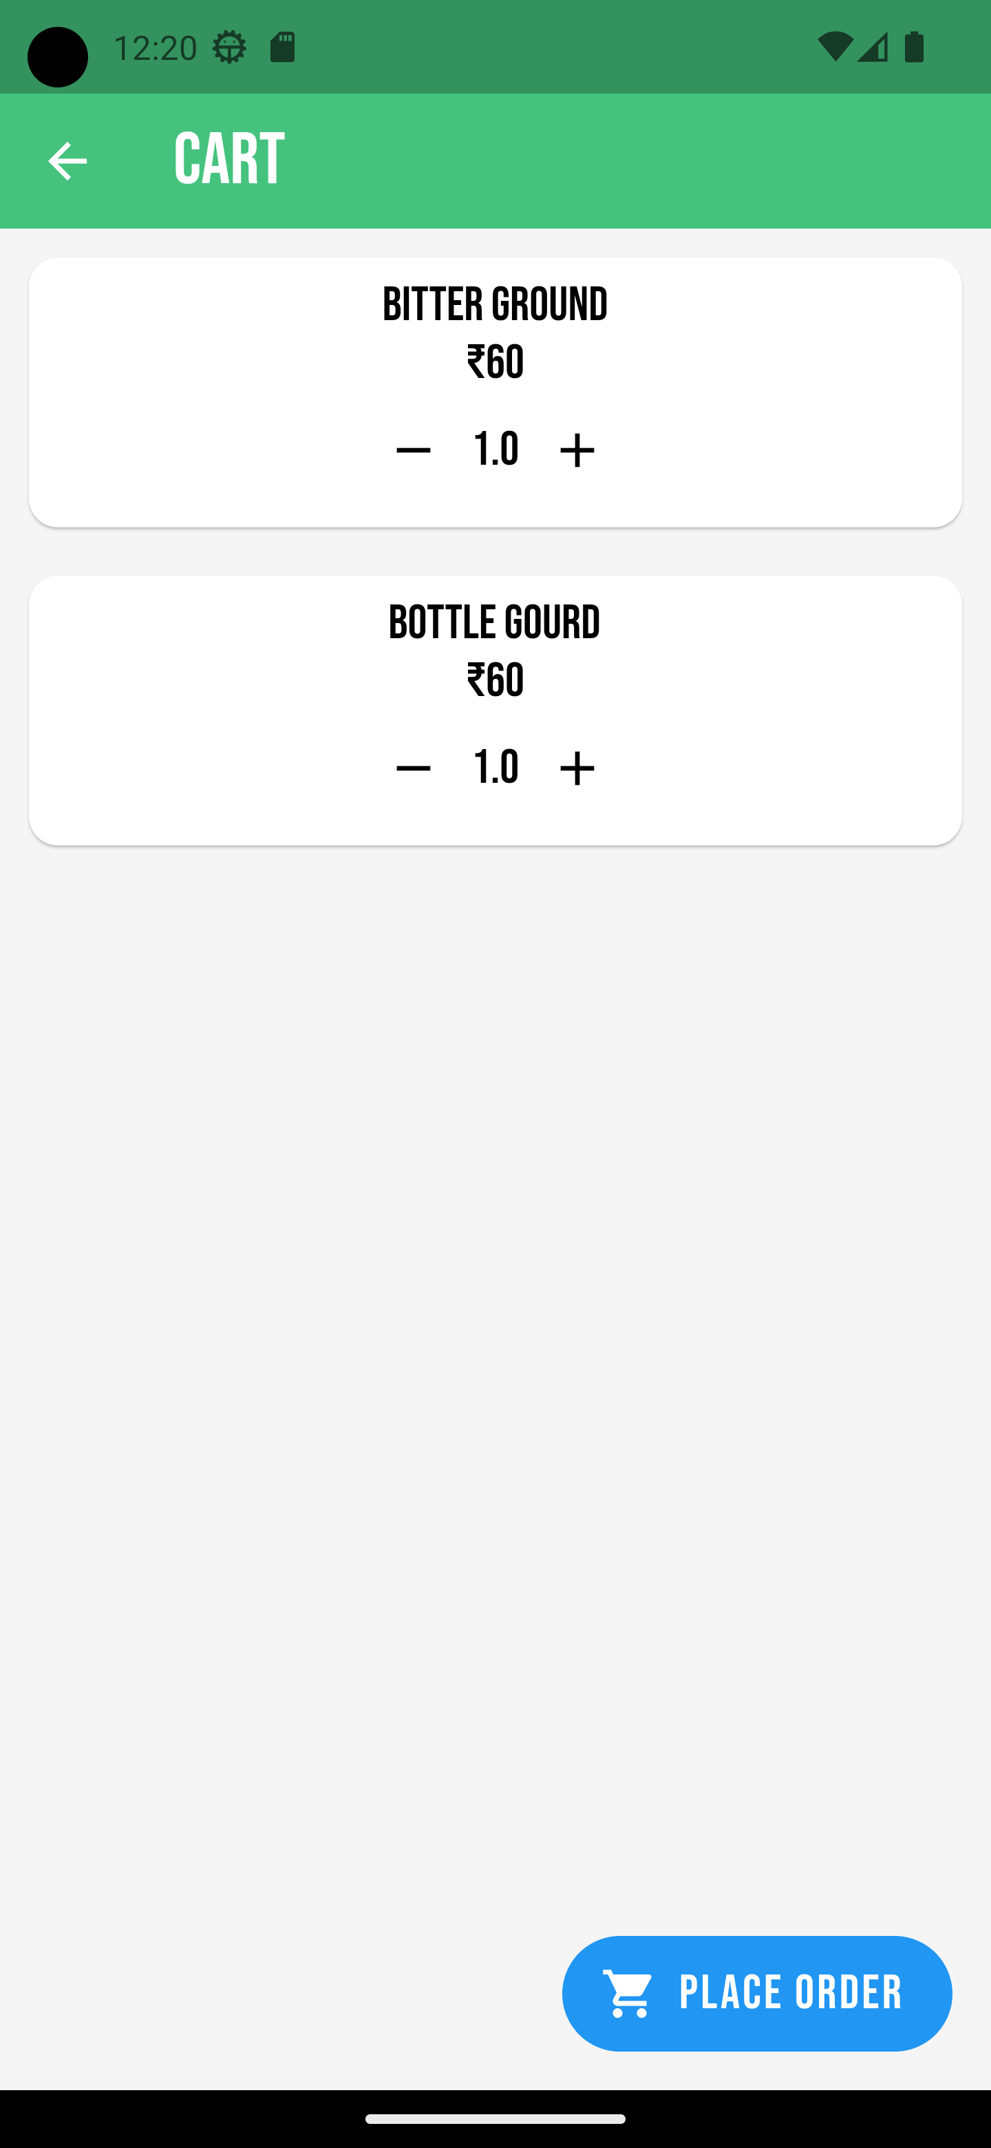
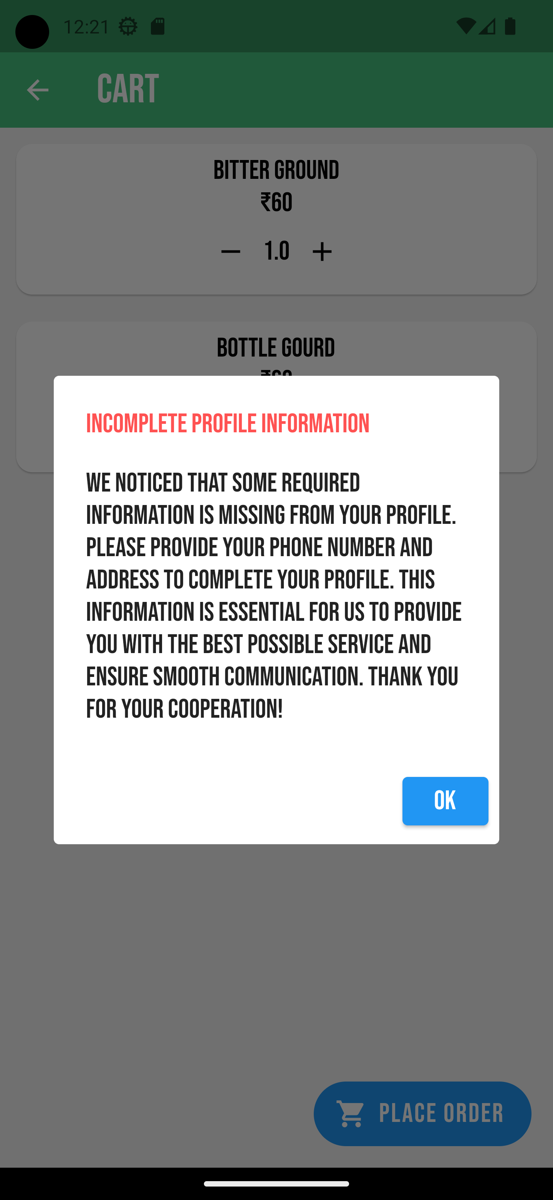
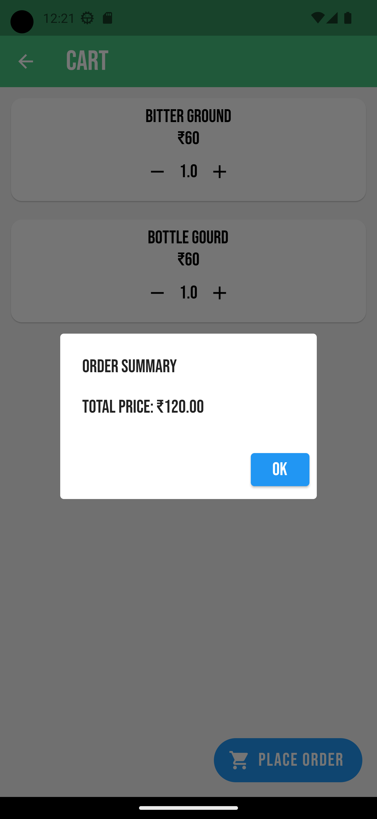
14
- Screen shots -

Slide 18
Thank you

